Slide 1
Mitigating Vulnerabilities

Slide 2
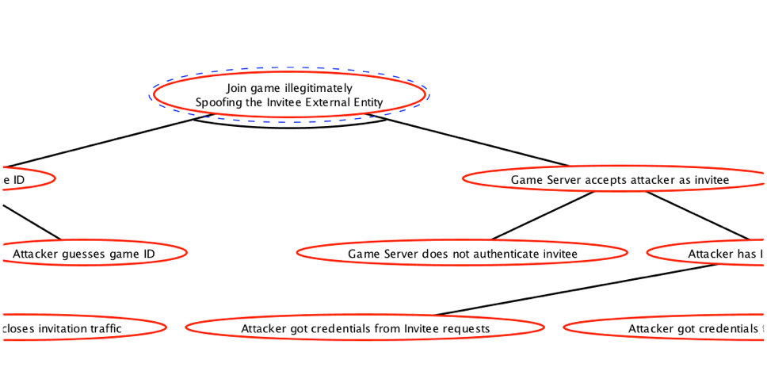

Sometimes it’s self-evident
“Make this not happen”
Notes:
First, mitigations happen at the bottom of a tree—if a node has children, then it’s the children that have to be mitigated. (If you have a situation where a node can be independently mitigated, then represent that possibility as an AND node next to the other children—in other words, “this has to not be true, AND THEN this other stuff has to be true”).
These leaf nodes will usually fall into one of three types. Often, a node is extremely specific—“attacker guesses game ID” is very specific, and the mitigation [CLICK] is just “make them not guessable”.

Slide 3

Sometimes it’s another tree
“See Attack Tree #28”
Notes:
Other times, the node actually represents another tree. Here, this node is just a rephrased version of “Information Discloure of Invitee Request Data Flow”. To find a mitigation for this node, you’d construct the attack tree for that threat.

Slide 4
Sometimes you’re not sure
Notes:
Often, the node will be something hypothetical, that you’re not sure is possible, or that is outside the scope of your threat model. [CLICK] Let’s suppose here that we’re not on the team doing authentication, so we don’t really know anything about how the auth for our game works; we don’t have access to a threat model for it. Basically, what we’ve done here is identified a threat. We don’t want to create an entire attack tree for this; we just want to be able to document a straightforward mitigation.

Slide 5

STRIDE → Fault
Spoofing → lack of identity
Tampering → lack of integrity
Repudiation → lack of auditing
Information disclosure → lack of confidentiality
Denial of service → lack of availability
Elevation of privilege → lack of authorization
Notes:
STRIDE Suggests Mitigation
Spoofing —> authentication
Tampering —> digital signature
Repudiation —> auditing
Information disclosure —> encryption
Denial of service —> auditing & filtering
Elevation of privilege —> defensive coding

Slide 6
Fault → Mitigation
Identity → answer “who”
Integrity → answer “who + what”
Auditing → answer “who + what + when”
Confidentiality → keep hidden
Availability → eliminate waste
Elevation of privilege → identity + integrity
Notes:
STRIDE Suggests Mitigation
Spoofing —> authentication
Tampering —> digital signature
Repudiation —> auditing
Information disclosure —> encryption
Denial of service —> auditing & filtering
Elevation of privilege —> defensive coding

Slide 7
Mitigation Toolbox
Authentication
Signing
Logging
Secrecy
Filtering
Defensive coding

Slide 8



Authentication
Determine whether an entity is in fact what it declares itself to be.
Something it knows
Something it has
Something it is
Also, chain of trust
Revocability & Duplicability
Notes:
Authentication is simply making sure an entity—whether a process, a data store or a human being—is what it declares itself to be. The way we do this is to check something it knows [CLICK]—a password—or check something it has [CLICK]—like an ID card—or something it is [CLICK]—like biometrics.
In the virtual realm, we mostly focus on things an entity knows, by necessity. [CLICK] But that introduces a couple of problems: revocability, and duplicability. [CLICK] Revocability just means we can deactivate it if it gets stolen. Duplicability means that we have to worry about whether it can be copied.

Slide 9
Authentication
Demonstrate possession of a shared secret without revealing it
Notes:
In practice what this means is that authenticating an entity requires demonstrating possession of a shared secret without revealing it. One way to do that is to encrypt the secret and send it over the wire… though the danger there is that you have to authenticate the entity you’re sending that secret to. A more sophisticated approach is to use the shared secret to sign a message. We’ll talk about encryption later; we’ll talk about signatures right now.

Slide 10
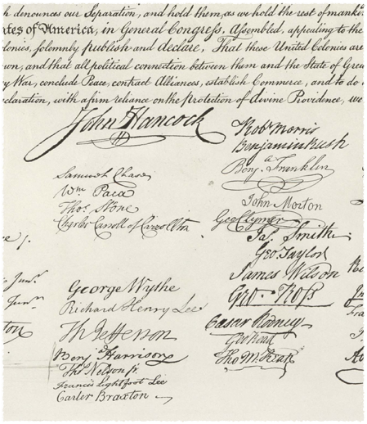

Signing
Determine whether a document is what an entity intended to send.
Hash
Shared secret
Notes:
Signing is a process by which we establish that a document is what an entity intended to send. The keys here are [CLICK] document and entity—we need to examine the entirety of the document, and we need the operation to be performable only by the author. We can accomplish the former with [CLICK] a hash function. [y’all know about hashing, right? map arbitrary input to fixed output?] We accomplish the latter with, once again, a shared secret.

Slide 11
Hashes, Digests and Signatures
A hash reduces an arbitrary document to a fixed-size representation
A digest is a hash function where documents with even tiny differences are nearly guaranteed to have very different hashes
Ideally, also hard to invert
A signature is a digest coupled with a shared secret
Notes:
Hashes, Digests and Signatures
A hash reduces an arbitrary document to a fixed-size representation
A digest is a hash function where documents with even tiny differences are nearly guaranteed to have very different hashes
Ideally, also hard to invert [and that’s what makes them “cryptographic hashes”]
A signature is a digest coupled with a shared secret

Slide 12
Cryptographic Hashes
MD5, SHA-1, SHA-256, etc.
Generally take a block (512 bits) of data, perform a series of shifts, rotates and XORs on the data, and repeat the process 20 to 40 times.
Around 300,000,000 blocks a second on modern hardware.

Slide 13
Cryptographic Hashes
The danger of relying on hashes is the chance of collisions
The “birthday paradox” gives the basic chance of a collision as ~sqrt(keysize); weak hash algorithms offer ways to beat that
Accidental collisions are almost impossible with any reasonable key size; we’re talking about the attacker finding a deliberate collision.

Slide 14
Replay Attacks
Special kind of spoofing attack that involves replaying portions of a previous (valid) operation
Mitigate with:
Time values
Message IDs or sequence numbers
Nonces

Slide 15
Nonces
A value used on just one occasion
A temporary shared secret
Generally a random number
But rand() won’t cut it!
Even if you seed it from an unpredictable source
Cryptographically-secure RNGs generate unpredictable results… and take longer, natch
Notes:
Nonces
A value used on just one occasion
A temporary shared secret
Generally a random number
But rand() won’t cut it!
Even if you seed it from an unpredictable source
Note that the clock is NOT unpredictable. Nor is something time-based like “how long has my program been running”. (How can an attacker know that? Well, what if the attacker is the one who caused your program to reboot?)
Cryptographically-secure RNGs generate unpredictable results

Slide 16

Logging
Log important activity for later review.
Authenticated users
Client keys
IP addresses
Notes:
The mitigation for a repudiation attack is to record the activity. Logging means to record information about each important/interesting event—source, target, time. If you later detect a problem, you can review the logs to see how it happened.
Sometimes this can be used to mitigate tampering, but that requires a backup of the known-good state of the data, and you may not have such a backup. For example, let’s say you’re preventing item duplication in WoW (a tampering attack against the inventory database). A good audit log will let you track down when duping occurs, but you may not be able to roll back the database, because many other actions subsequent to the dupe could have happened—including ones that relied on the dupe. What the audit log lets you do is ban the user responsible for the duping.
To get the most value out of an audit log, you need authenticated users [CLICK]. But you could also weakly authenticate clients [CLICK]—for example, on iPhone and Android you have access to a unique, semi-reliable device ID. You can also [CLICK] log by IP address, which is often the best you can do—many websites ban commenters based on IP address. IP addresses change over time, but not by huge amounts necessarily, and it’s hard to spoof IP addresses on TCP connections. [Everybody remember why?]

Slide 17
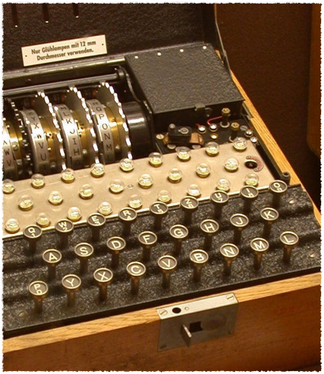
Encryption
Encodes a document so that only authorized parties can read it.
Symmetric: The same key encrypts and decrypts
Asymmetric: There are two keys, and each decrypts what the other encrypts
Notes:
You’re probably at least a little familiar with the concept of encryption: encoding data so that only someone with the shared secret can read it.
There are many encryption algorithms available, but they fall into two categories: [CLICK] symmetric ones, where one key handles both encryption and decryption, and [CLICK] asymmetric ones, where data you encrypt with one key can only be decrypted with the other.

Slide 18
Symmetric Ciphers
DES, 3DES, AES (formerly known as Rijndael)
Generally take a block (128 bits) of data, XOR it against a key, mutate the block and key and XOR again… for 10 or 15 rounds.
Around 200,000,000 blocks a second on modern hardware.
Notes:
Generally take a block (4 words) of data, XOR it against a key, mutate the block and key and XOR again… for 10 or 15 rounds.
Around 200,000,000 blocks a second on modern hardware.

Slide 19
Symmetric Key Size
A cipher is considered secure if there is no better attack than brute force.
There are 18,500,000,000,000,000,000 64-bit keys.
At 200M a second, that’d take 2,933 years.
Or it’d take 1M computers one day.
So we use 128-bit keys.
When quantum computing gets solved, we’ll have to switch to 256-bit keys.
Notes:
pronounced “18.5 quintillion”
Here’s an interesting thing: you basically measure the security of a crypto system in terms of speed—how long it would take to break. The bigger the key, the longer the algorithm takes… but the longer it would take an attacker.

Slide 20
Asymmetric Ciphers
RSA, Elliptic Curve Cryptography
Encryption and decryption involve raising very large numbers to the power of other very large numbers… not cheap, and not suitable for large data.
Around 1,500 blocks a second on modern hardware.
Notes:
RSA, Elliptic Curve Cryptography
Encryption and decryption involve raising very large numbers to the power of other very large numbers… not cheap, and not suitable for large data.
Around 1,500 blocks a second on modern hardware.

Slide 21


Asymmetric Key Size
An RSA key is derived from two prime numbers multiplied together. A “2048-bit key” is a pair of roughly-1024-bit primes… and if you know one you automatically know the other.
There are a lot of 2048-bit numbers… but there’s not remotely as many 1024-bit primes.
There’s about as many 1,624-bit primes as there are 128-bit numbers.
1024-bit keys are a few years away from being completely cracked. 2048-bit RSA keys are okay for now, but the cool kids use 4096 bits.
Constant risk that someone will discover a mathematical “trap door” to factor large numbers quickly…
Notes:
An RSA key is derived from two prime numbers multiplied together. A “2048-bit key” is a pair of roughly-1024-bit primes… and if you know one you automatically know the other.
There are a lot of 2048-bit numbers… but there’s not remotely as many 1024-bit primes. Which points out a critical consideration: Any constraints on a key will dramatically reduce the space we have to search for a brute-force attack.
There’s about as many 1,624-bit primes as there are 128-bit numbers.
1024-bit keys are a few years away from being completely cracked. 2048-bit RSA keys are okay for now, but the cool kids use 4096 bits.
Constant risk that someone will discover a mathematical “trap door” to factor large numbers quickly…
[CLICK]…which is the plot of the movie Sneakers (1992), which is one of the favorite movies of every security professional. The heroes are a penetration-testing team! …it won’t be on the test.

Slide 22
Key Exchange
Alice generates a random 128-bit AES key.
Alice encrypts it with Bob’s public RSA key.
Alice sends the encrypted AES key to Bob.
Bob decrypts the AES key with his private RSA key.
Bob and Alice now have a shared secret.
…as long as it’s really Bob and Alice.
…and as long as it’s really secret.
Notes:
TALK ABOUT CRYPTOGRAPHICALLY SECURE RNGS!

Slide 23
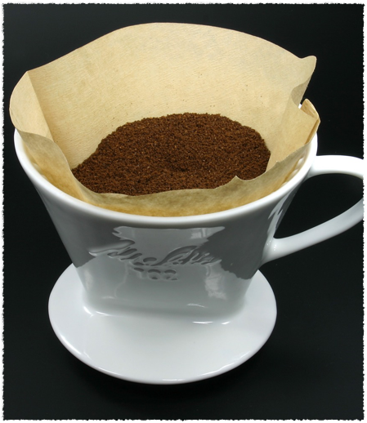
Filtering
Reject invalid or abusive activity as efficiently as possible.
Be careful this doesn’t leak information…
…or deny service to legitimate users
Notes:
Filtering just means to reject bogus activity as quickly as possible. Often this is done at a firewall—if you remember Netgear’s inadvertent DDoS attack against the University of Wisconsin, their firewall now simply bounces all traffic coming from the flawed code. Other times you can do this in your code. Throttling is the same idea, except you treat excessive packet rates as ipso facto invalid.
But be careful this doesn’t leak information. For example, let’s say you have an authenticated API to get a player’s inventory. You might be tempted to say, “well, if a request comes in for the inventory of a player who doesn’t exist, I won’t even bother authenticating it—I’ll save some cycles and just return 404 right away”. Now you’ve given an attacker a way to enumerate every player ID in your system.

Slide 24
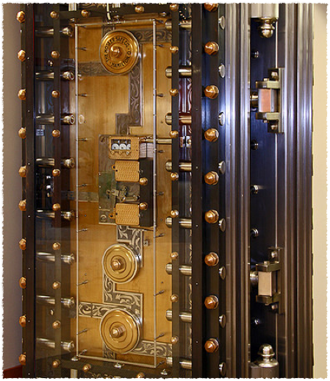
Defensive Coding
Ensure continuing safe function despite unexpected or malicious input.
Notes:
Too much to cover in this deck—it gets its own deck next.

Slide 25
Defensive Coding Techniques
Handle errors
Beware information disclosure in error messages
Fail “safe”
Watch out for:
Buffer overruns
Integer overflows

Slide 26
Mitigation Toolbox
Authentication via shared secrets
Signing via cryptographically-secure hashes of data combined with shared secrets
Beware of replay attacks and weak RNGs!
Auditing via logging
Encryption via symmetric or asymmetric ciphers
Filtering to impose reasonable limits on data flows
Defensive coding practices such as input validation
Notes:
Authentication via shared secrets
Signing via cryptographically-secure hashes of data combined with shared secrets
Beware of replay attacks and weak RNGs!
Auditing via logging
Encryption via symmetric or asymmetric ciphers
Filtering to impose reasonable limits on data flows
Defensive coding practices such as input validation, fuzz testing

Slide 27
Five by Five
It’s easy to inject packets into the middle of a UDP conversation. It’s harder to do with a TCP conversation. Explain why that is, using terms from this deck. What kind of STRIDE attack would this represent?

Slide 28
Five by Five
The checksum in UDP and TCP headers is a simple form of __________, and thus can be considered a mitigation against some trivial _________ attacks. Describe briefly how an attacker could defeat it. How would a defender mitigate that, and what would it cost?

Slide 29
Five by Five
Replay attacks are a form of _______. List three things you could include in a packet or request to defend against replay attacks.

Slide 30
Five by Five
Filtering is a defense against ________ attacks. If poorly implemented, however, it can itself become a vector for ________ and ________ attacks. Give a one-sentence example of each of those two attacks against a filtering mechanism.

Slide 31
Five by Five
The old standard for encrypting browser connections was called _____; the new version is called _____. Both will reliably encrypt a TCP stream. However, simply encrypting the stream isn’t sufficient—the client must also protect against _______ attacks by doing what?

